Slide 1

Python data analytics
for merE mortals
Notes:
Good afternoon everyone, and thank you for coming out today. We only have a short amount of time together to today, so I’m gonna jump right in. My name is James White, I’m an Expert Engineer Alumnus and 11 year veteran of the firm; started as a Data Center engineer in GTI before going into app development. I’v been a developer and AD manager for the past 8 years in infrastructure software spaces in GTI and CCB. Today I’m here to talk to you about data analytics in Python.

Slide 2
Objectives
Learn the difference between data “science” and “analysis”, and understand the characteristics (and toolsets) of their practitioners.
Learn how to use Python (with a few 3rd party modules) to modernize your data transformation, analysis, and visualization tasks
Learn how to integrate these new tools and techniques into your everyday business workflows and applications
Notes:
We have 3 big objectives for the next 45 min: 1.) Learn about the differences between what the average person considers data science vs data analytics. 2.) Learn how to use Python to transform and automate many of our highly manual day-to-day analysis tasks. 3.) And finally, learn how to integrate these tools an techniques into our everyday. Please hold your questions till the end, or find me after the talk… I’ll be in the gathering space out front.

Slide 3

Who This is for
Primary Audience
Application developers
Data/Business analysts *
Excel masters *
Anyone interested in
Simple data analysis
Static & Dynamic reporting
Excel automation
Integration with other apps/tools
* some coding experience required
Notes:
This demo is designed for everyone from developers, Excel masters, and everyday data analysts. Anyone interested in data science, analysis, reporting, or automation will benefit from this demo. That said, we will be reading and writing code; so some degree of coding experience is required. If you can read Perl, VBA, or Powershell you should have no problem following along.

Slide 4
Data Science
An interdisciplinary field about processes and systems used to extract knowledge or insights from data in various forms, either structured or unstructured
Data Analytics
The science of examining raw data with the purpose of drawing conclusions about that information.
Notes:
First thing we have to do is clear up any ambiguity around how we define data “science” and “analytics”. Everyone seems to define this a little differently, but for the purposes of this demo we will define them as follows. Data science is about processes and tools used to extract information, finding the diamond in the rough. Analytics is about examining that information and drawing conclusions, determining the worth of the diamond. But lets dig a little deeper…

Slide 5


Different Practices
Patterns, correlations, models
Output
Reports, KPIs, trends
Exploratory, experimental
Process
Static, comparative
On the fly, as-needed
Sources
Planned, added slowly
“Good enough”, probability
Quality
Single version of truth
Predictive, prescriptive
Analysis
Retrospective, descriptive
Data Science
Data Analytics
Notes:
When we compare the two practices we can immediately see some key differences.

Slide 6
Different practitioners
I feel comfortable operating
with incomplete data
I want to have a
complete set of data
My data files
are often messy
My data files
are usually clean
I explore data to see
what it tells me
I report on what
the data says
My dataset is so big, managing
it is part of the problem
My dataset can get big,
but it’s currently manageable
My findings help
predict the future
My findings help
measure the past
Data Scientists
Data Analysts
Notes:
The tolerances of the practitioners are also very different. One playing a little fast and loose; exploring huge, incomplete, and messy data in an attempt to predict the future. And the other requiring much more rigor, reporting what is or has happened through relatively clean and complete datasets.

Slide 7
Different Tools
Hadoop, Java, Python,
SQL, NoSQL, Excel, etc.
Capture
Excel, VBA, SQL, etc.
R, Python, Excel, SAS, etc…
Analyze
Excel, VBA, SQL, etc.
R, Flare, HighCharts,
AmCharts, D3.js,
Bokeh, Excel, etc.
Present
Excel, Business objects, etc.
Data Science
Data Analytics
Notes:
And now we get to the tools - as you can see the average data scientist has a huge arsenal at their disposal. Thats not to say that these tools couldn’t be used in everyday analysis, but lets be honest… we live and die by Excel and its relative languages.

Slide 8
With that said
There is commonality, but huge differences…
Both leverage scripting languages, but usually for different purposes
Both source from SQL databases and flat files, but at very different scale
Both use Excel all over the place, but only one is reliant on it
So today, our focus is on simple analytics only…
Automating our complicated Excel tasks
Simplifying analysis tasks and report generation
Creating sophisticated visualizations
Integrating with other applications/tools
With the goal of taking our current skill sets…
Notes:
So to bring this tangent to an end: there is some overlap between data science and analytics, but huge differences. Similar languages but for different purposes. Similar data sources but at different scale. Everyone uses Excel, but only one requires it. Today we are focusing on analytical tasks only; simplification, automation, visualization, etc.

Slide 9
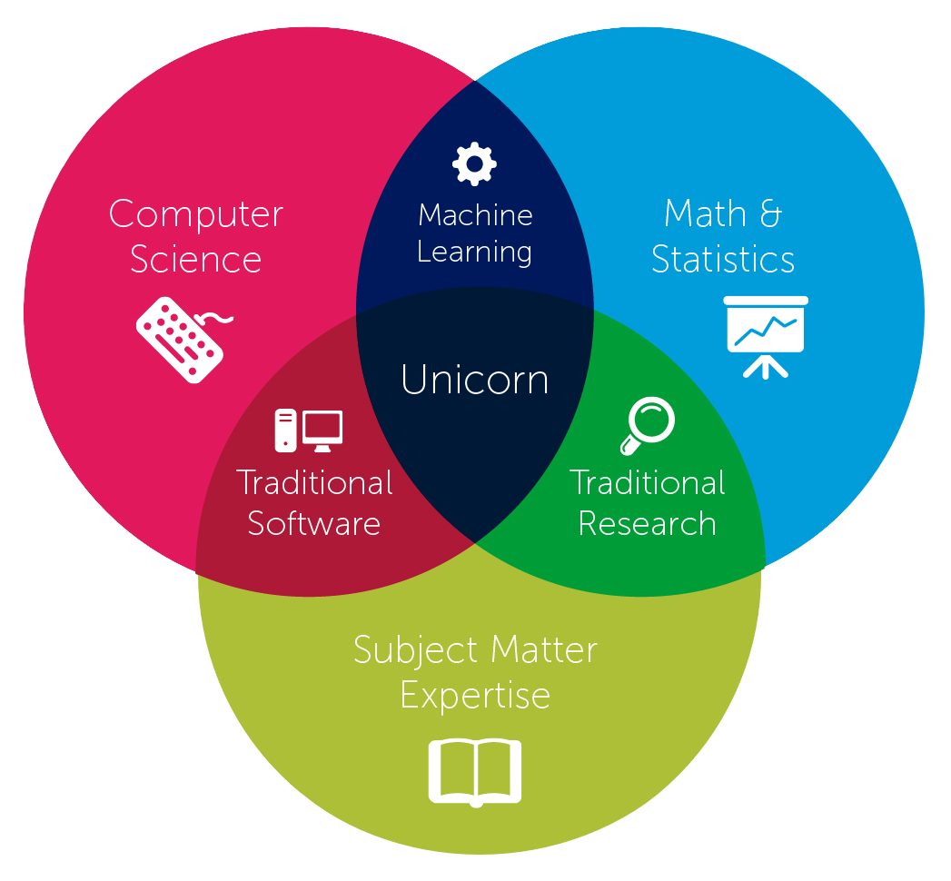
from here…
Notes:
Traditional software developers: building tools used by the business to analyze data.
Traditional research roles: drawing conclusions from analyzed data.

Slide 10
… to here
Notes:
The mythical business unicorn - capable of both divining meaning from data as well as building your own tools to automate analysis processes.

Slide 11
The tools we will use
NumPy - the fundamental package for scientific computing with Python
Pandas - library providing high-performance, easy-to-use data structures and data analysis tools for Python
ipython/jupyter - a web application that allows you to interactively create and share documents that contain live code, equations, visualizations and explanatory text
Bokeh - interactive visualization library for Python that targets modern web browsers for presentation
FuzzyWuzzy - fuzzy string matching in Python like a boss
Notes:
NumPy - largely as a companion for other tools. Leveraging scientific data-types it includes.
Pandas - our primary analytical tool for the day. Pandas provides us with a crazy powerful DataFrame object that is similar to a spreadsheet in both its composition and functionality: sorting filtering, pivoting, calculating, all that good stuff.
Jupiter will be our primary IDE for this afternoon - you will see why soon enough.
Bokeh will be used to create web based interactive charts.
FuzzyWuzzy for string matching.

Slide 12
Why Python?
Easy enough for almost anyone to learn
Painless to install - one click in Developer xChange
Flexible enough to use for almost anything
Powerful enough to build robust apps
Adaptable enough to run on any platform
Notes:
Why use Python, when we are clearly a Java biased organization? Many universities have migrated to Python for its intro courses. Flexible: supports procedural, functional, and OOP constructs out of the box. Powerful: Instagram, Dropbox, Pinterest - huge. Adaptable: runs on Linux, windows, mobile, and JVM. Can call C, Java, and .NET libs depending on implementation.

Slide 13
scenario
We need to perform some basic analysis against a set of sales data with the following requirements:
The data comes to us in several parts that we need to combine prior to analysis, and the format of each part is a little different.
Next, we need to add a calculated column to the end of the combined data set. While we are at it, clean up any data quality issues.
We then need to join the results to a different set of data that contains a common key - similar to a table join in SQL.
Finally, we must join to yet another source of data based on rough string matching and quantify our match strength - like a super complex vlookup on steroids.
Notes:
The best way to demo these tools is to walk through a realistic business scenario. So lets pretend that we need to preform some cleanup and analysis of some sales data that we collecting in flat files and come from several different people, in different formats, at different scale. Then we’ll add some calculated columns, cleanup and fill-in missing values, as well as join in additional data from both clean and dirty sources.

Slide 14
OUTPUT
Once we have completed all the tasks on the prior slide we will need to produce various forms of output :
A simple spreadsheet with all rows and columns from our result set
Another spreadsheet pre-pivoted by a set of columns, including simple aggregates
A third spreadsheet that has a different cross-section of the pivot above on each tab
An interactive chart that can be integrated into… whatever
Notes:
As part of the scenario we will need to produce various outputs.

Slide 15
Our Constraints
30 minutes to complete all tasks
Must be repeatable

Slide 16
READY.
SET.
DEMO!

Slide 17
Recap
There is a big difference between data “science” and “analysis”, make sure you use the correct term in the correct context
Nothing is wrong with Excel, but we can do many of the advanced Excel-ish stuff WAY faster and more repeatably in Python w/ Pandas
VBA is great for MS Office automation, but it isn’t as full featured as Python and you can’t build “real” apps with it
Everyone likes interactive charts, give the people what they want ;-)

Slide 18
Materials
All materials available on GitHub https://github.com/jpwhite3/python-analytics-demo

Slide 19
References
http://www.forbes.com/sites/piyankajain/2013/02/25/data-science-or-analytics/
http://www.edureka.co/blog/core-data-scientist-skills/
http://pbpython.com
http://www.marketingdistillery.com/
http://pandas.pydata.org
http://bokeh.pydata.org/en/latest
https://www.continuum.io/why-anaconda
https://s3.amazonaws.com/quandl-static-content/Documents/Quandl+-+Pandas,+SciPy,+NumPy+Cheat+Sheet.pdf

Slide 20
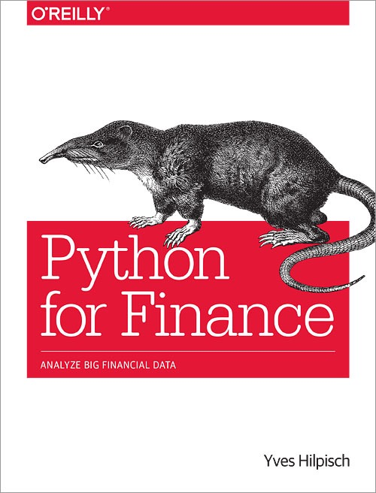
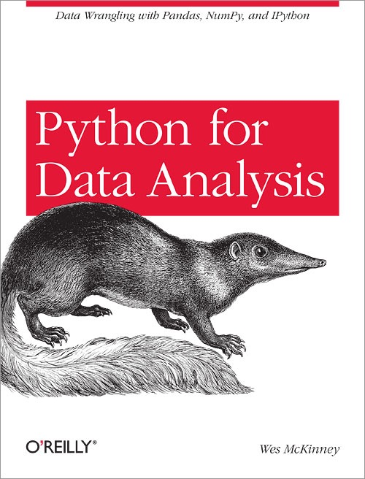
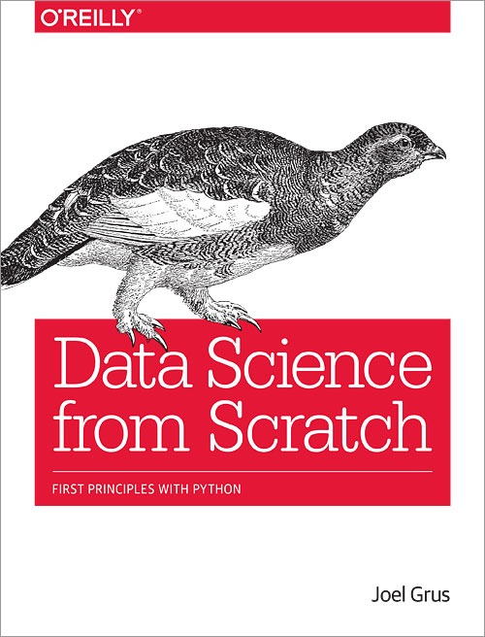
More References

